Slide 1

Quickgarde A Plug-in for Detecting Cyberbullying Occurrences in Filipino Social Media Posts
A research and development project presented to you by:
Ballesteros | Capuz | Mallari | Samillano

Slide 2

Cyberbullying
A form of harassment
Occurs via the Internet

Slide 3



How Social Media Deal with Cyberbullying
Privacy Settings
Reporting Tools
YouTube’s Safety Mode
Twitter’s Mute Feature
Notes:
MRO purchases often approach 40 percent of a manufacturing company’s
total revenues (external costs)
Companies face significant internal costs resulting from outdated and cumbersome MRO management processes

Slide 4

Laws Related to Cyberbullying
R.A. 10627 – Anti-bullying Act of 2013
House Bill 5718

Slide 7


Slide 8

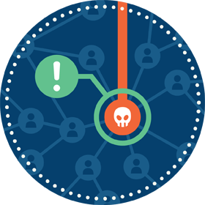

Features
Detect
Flag
Report
Notes:
MRO purchases often approach 40 percent of a manufacturing company’s
total revenues (external costs)
Companies face significant internal costs resulting from outdated and cumbersome MRO management processes

Slide 9





Significance
To social media moderators
To Filipino social media users
To the researchers
To anti-cyberbullying advocates
Notes:
MRO purchases often approach 40 percent of a manufacturing company’s
total revenues (external costs)
Companies face significant internal costs resulting from outdated and cumbersome MRO management processes

Slide 10
How was Quickgarde created?

Slide 11
Research
1
Creation and Training of the Model

Slide 12
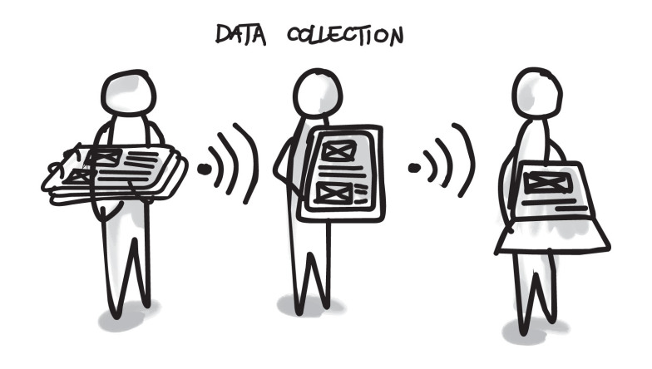
Data Collection
2000 public posts were gathered from Facebook, Twitter, and YouTube

Slide 13
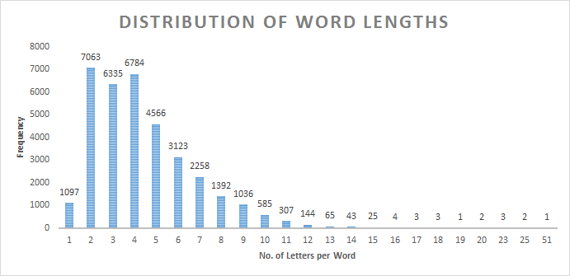
Data Description
Length of words per statement

Slide 14
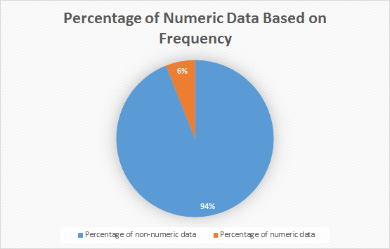
Data Description
Presence of numeric data

Slide 15
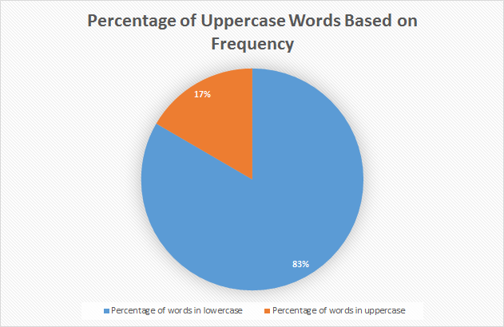
Data Description
Percentage of words in upper case

Slide 16
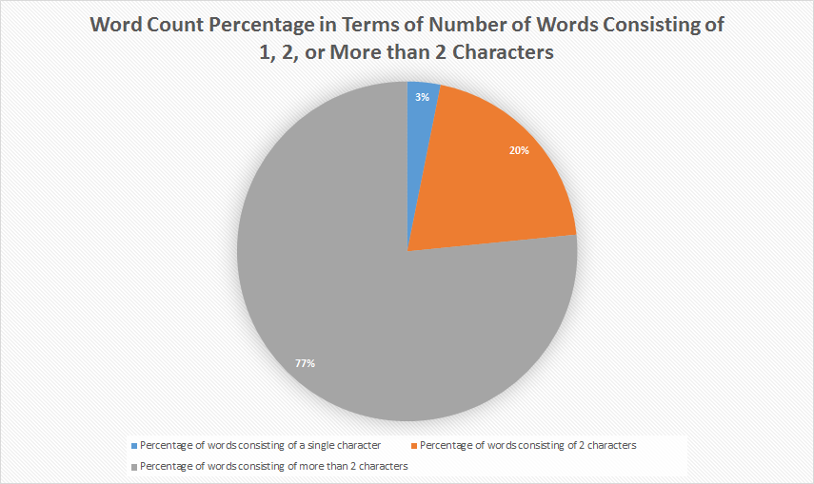
Data Description
Presence of words consisting of single and double characters

Slide 17
Data Description
Top 50 cyberbullying keywords
Rank | Word(s) | No. of occurrences
1 | INA/unu | 566
2 | TANG/tung | 210
3 | puta/putang/pota/PUTANGINA/pokeng | 155
4 | Hahahaha/Hihi/Hehehe | 153
5 | baba | 137
6 | gay | 122
7 | fuck/fucking/FUCKIN/pakyu | 97
8 | HAYOP/KABAYO/ANIMAL/daga/pet/baboy | 95
9 | mamatay/hell/Kill/patay/bitayin | 93
10 | LANDI/itch | 88
11 | gang | 70
12 | pusher/druglord/lord/drug | 70
13 | tawa/Kakatawa | 69
14 | BIG | 64
15 | gago/tado | 62
16 | King | 61
17 | tanga/ulol/ulul | 52

Slide 18
Data Description
Top 50 cyberbullying keywords
18 | gaga | 47
19 | malandi/Kalandi/baliw/abnoy | 45
20 | loko | 42
21 | bakla/Kadiri | 41
22 | ass/Butt | 39
23 | che | 37
24 | mahina/matanda/slow | 37
25 | hiya | 35
26 | bitch/tarantado | 35
27 | bobo/stupid/kupal | 33
28 | bad | 30
29 | paa/TAE | 29
30 | panga | 26
31 | wawa/Kaawa | 26
32 | baho/kati | 25
33 | punyeta/shit/bwiset/Bullshit | 24
34 | tangina | 23
35 | yaya | 23

Slide 19
Data Description
Top 50 cyberbullying keywords
36 | adik/salot | 22
37 | mahirap | 21
38 | pabebe/epal | 21
39 | malaki | 17
40 | pangit | 17
41 | BLACK/FAT/Blind/sunog | 17
42 | Bayag/pepe/etits/tuwad/pakantot /boobs/penis | 17
43 | Kapal | 15
44 | Yuck/Ewww | 8
45 | HYPOCRITE/pathetic | 6
46 | bruha/halimaw | 6
47 | demonyo | 4
48 | yawa | 4
49 | engot | 3
50 | inarte | 1

Slide 20
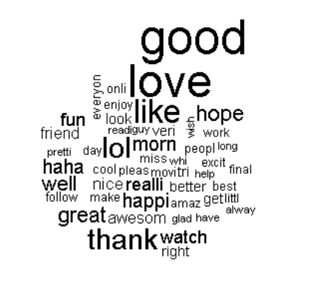
Text Preprocessing
Cleaning of the dataset
Tokenization
Conversion of data to Bag-of-words

Slide 21
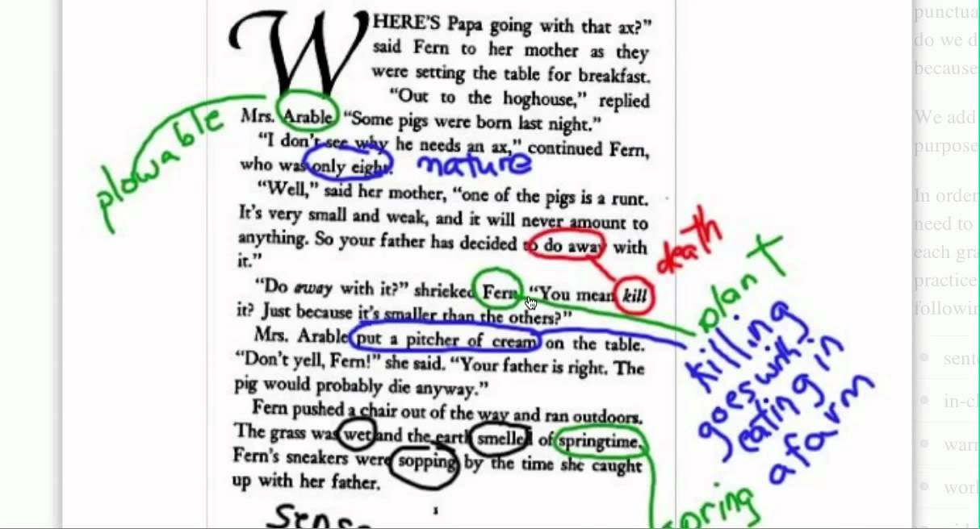
Text Annotation
Annotation schemes used:
Cyberbullying
Not Cyberbullying
Ambiguous Cyberbullying

Slide 22
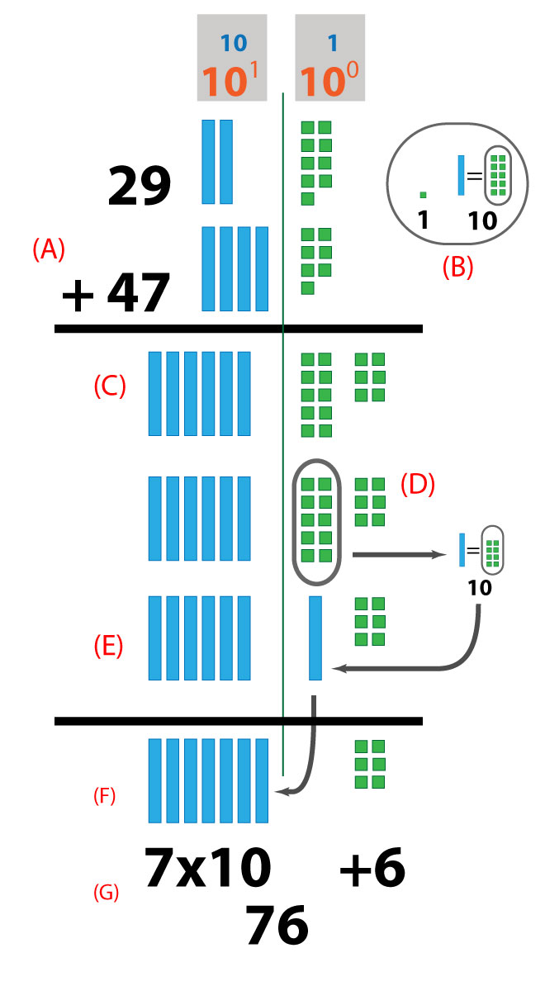
Model Implementation
The created model was implemented using Support Vector Machine (SVM) algorithm through WEKA

Slide 23
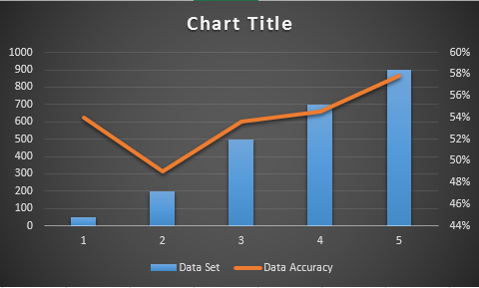
Data Analysis
Adding more training data in the dataset

Slide 24
Data Analysis
Percentage split
Training Data (%) | Testing Data (%) | Accuracy | Kappa Statistics
60 | 40 | 45.8824 | 0.0911
70 | 30 | 47.3333 | 0.114
80 | 20 | 55 | 0.2177
90 | 10 | 50 | 0.1325

Slide 25
Data Analysis
K-fold cross validation
K-Fold | Accuracy | Kappa Statistics
2 | 57.65 | 0.1933
3 | 57.65 | 0.2007
4 | 58.2 | 0.2082
6 | 58.05 | 0.2096
7 | 58.15 | 0.2081
8 | 58.85 | 0.2288
9 | 56.95 | 0.2084
10 | 57.95 | 0.2094

Slide 26
Data Analysis
Using different algorithms
Algorithm | Accuracy | Kappa Statistics | Time (seconds)
SVM | 57 | 0.2094 | 47.56
Naïve Bayes | 45.8 | 0.1272 | 4.98
J48 | 53.7 | 0.1619 | 61.84
ZeroR | 56.9 | 0 | 0.02
Decision Stump | 56.9 | 0 | 2.78
RandomTree | 48.55 | 0.1008 | 2.97
RandomForest | 61 | 0.1712 | 40.25
RepTREE | 56.9 | 0.1026 | 14.04
HoeffdingTree | 56.9 | 0 | 17.19
DesicionTable | 58.8 | 0.1173 | 628.02
JRip | 57.9 | 0.0594 | 48.21
OneR | 55 | 0.0431 | 1.45

Slide 27
Development
2
Development and testing of Quickgarde

Slide 28



Tools used:

Slide 29
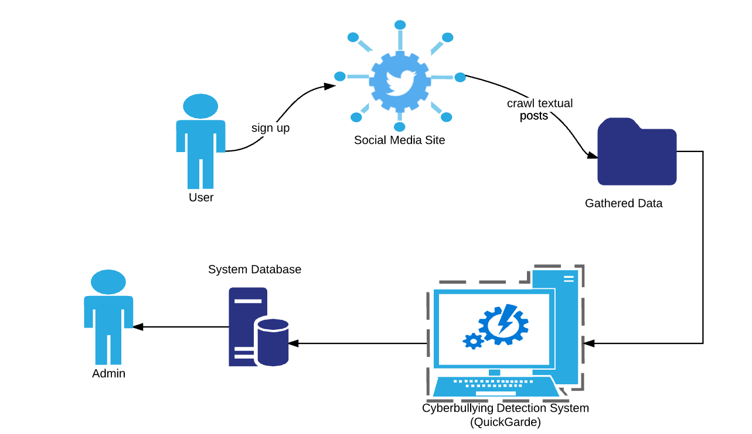
System Architecture

Slide 30
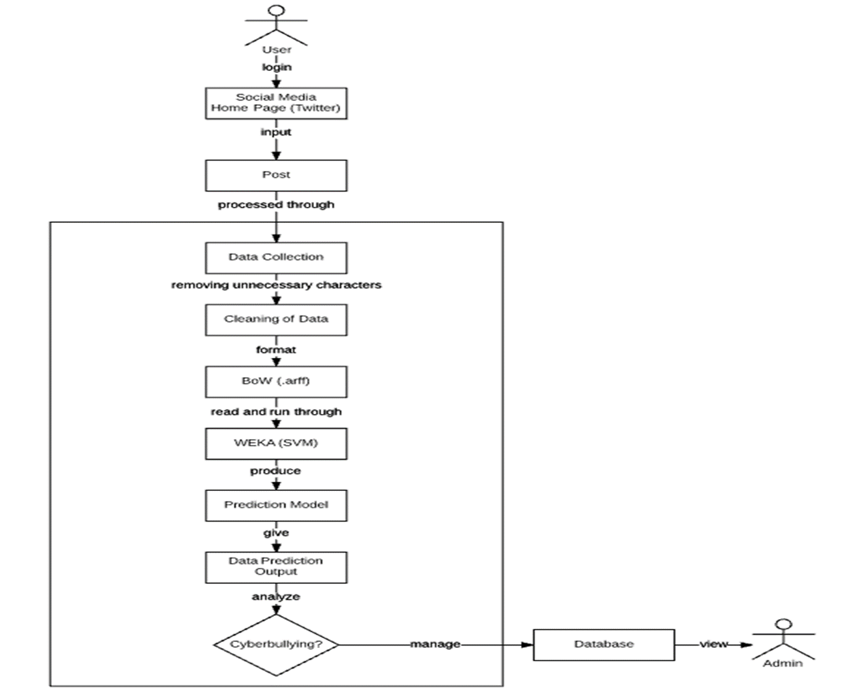
System Architecture

Slide 31
Demo Underway

Slide 32

Conclusion and Recommendations

Slide 33
Questions?

Slide 34
Thank You!

